Slide 1
SPAM SMS FILTERING USING MACHINE LEARNING
MUBASHIRA A
Roll No:29
Product Owner : MR. VASUDEVAN T V

Slide 2
TABLE OF CONTENTS
Introduction
Modules
Developing Environment
Product backlog
User story
Project plan
Sprint plan
Sprint 1 actual

Slide 3
Introduction
Due to its convenient, economical, fast, and easy to use nature messaging systems is a vital revolution taking place over traditional communication systems.
A main obstruction in electronic communications is the vast publicizing of unwanted, harmful messages known as spam messages. Lots of time of client is being wasted for sorting approaching these messages and erasing undesirable correspondence, so there is a need for spam detection so that its outcomes can be reduced.
The main aim is to development of suitable filters that can appropriately detect those messages and results in a high-performance rate.
In this project, Spam Detection aims to differentiate between spam and authorized messages. Here, the evaluation of it is done by using a Machine Learning algorithm named SVM.
Machine learning algorithms, especially Support Vector Machine (SVM), can play a major role in spam detection. In this project, the classification is done by defining feature vectors calculated by TF-IDF values.

Slide 4
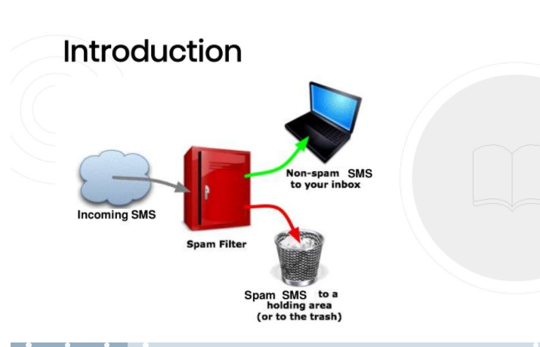

Slide 5
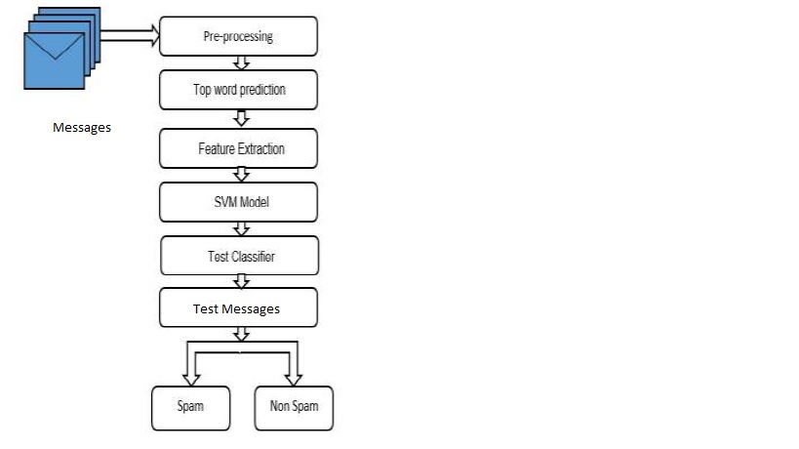
Basic Architecture

Slide 6
MODULES
admin
administration
USER
Data collection
User authentication
Training
Testing
Result

Slide 7
DEVELOPING ENVIRONMENT
HARDWARE SPECIFICATION
• Processor : i3
• Hard Disk : 500 GB
• RAM : 4 GB
SOFTWARE SPECIFICATION
• Language : Python
• Front End : Python-Django
• Back end : SQLite
• Dataset : Spam harm dataset from Kaggle website
• Algorithm : SVM
• IDE : Visual Studio Code , anaconda navigator
• OS : Windows

Slide 8
Product backlog
User Story ID | Priority < High /Medium /Low > | Size (Hours) | Sprint <#> | Status < Planned / InProgress / Completed > | Release Date | Release Goal
1 | High | 5 | 1 | Completed | 27/12/21 | Collect spam ham dataset from Kaggle website
2 | Medium | 5 |  | Completed | 28/12/21 | Data pre-processing
3 | Medium | 5 | 2 | Completed | 29/12/21 - 30/12/21 | User Interface Design
4 | High | 10 |  | Planned | 15/01/22 - 16/01/22 | Result data collection form
5 | High | 7 | 3 | Planned | 22/01/22 - 23/01/22 | Training the dataset
6 | High | 8 |  | Planned | 29/01/22 - 30/02/22 | Apply SVM Algorithm and create model
7 | High | 8 | 4 | Planned | 05/02/22 - 06/02/22 | Testing and predicting (whether it is spam or not)
8 | High | 2 |  | Planned | 12/02/22 | Output generation

Slide 9
User story
User Story ID | As a type of User | I want to <perform some task> | So that I can < Achieve Some Goal>
1 | User | Collection of datasets | spam harm dataset
2 | User | Creating data frames | Data pre-processing
3 | User | Create user interface | Data collection form
4 | User | Result data collection form | Printing form
5 | User | Training the data | View accuracy of the model
6 | User | Modelling the data | Model created with SVM Algorithm
7 | User | Testing the data | Collected user input
8 | User | Output generation | Output generated

Slide 10
Project plan
User Story ID | Task Name | Start Date | End Date | Days | Status
1 | Sprint 1 | 27/12/21 | 27/12/21 | 2 | Completed
2 |  | 28/12/21 | 28/12/21 |  | Completed
3 | Sprint 2 | 29/12/21 | 30/12/21 | 4 | Completed
4 |  | 15/01/22 | 16/01/22 |  | Planned
5 | Sprint 3 | 22/01/22 | 23/01/22 | 4 | Planned
6 |  | 29/01/22 | 30/01/22 |  | Planned
7 | Sprint 4 | 05/02/22 | 06/02/22 | 3 | Planned
8 |  | 12/02/22 | 12/02/22 |  | Planned

Slide 11
Sprint Backlog plan
Backlog Item | Status and Completion date | Original Estimate in hours | Day 1 | Day 2 | Day 3 | Day 4 | Day 5 | Day 6 | Day 7 | Day 8 | Day 9 | Day 10 | Day 11 | Day 12 | Day 13
User story #1,2 |  |  | Hours | Hours | Hours | Hours | Hours | Hours | Hours | Hours | Hours | Hours | Hours | Hours | Hours
Dataset Collection | 27/12/21 | 5 | 5 | 0 | 0 | 0 | 0 | 0 | 0 | 0 | 0 | 0 | 0 | 0 | 0
Analysis | 28/12/21 | 5 | 0 | 5 | 0 | 0 | 0 | 0 | 0 | 0 | 0 | 0 | 0 | 0 | 0
User story #3,4
UI Designing | 30/12/21 | 5 | 0 | 0 | 3 | 2 | 0 | 0 | 0 | 0 | 0 | 0 | 0 | 0 | 0
Coding | 16/01/22 | 10 | 0 | 0 | 0 | 0 | 5 | 5 | 0 | 0 | 0 | 0 | 0 | 0 | 0
User story #5,6
Training | 30/01/22 | 15 | 0 | 0 | 0 | 0 | 0 | 0 | 3 | 4 | 4 | 4 | 0 | 0 | 0
User story #7,8
Testing | 12/02/22 | 10 | 0 | 0 | 0 | 0 | 0 | 0 | 0 | 0 | 0 | 0 | 4 | 4 | 2
Total |  | 50 | 5 | 5 | 3 | 2 | 5 | 5 | 3 | 4 | 4 | 4 | 4 | 4 | 2

Slide 12
Sprint 1 Backlog Actual
Backlog Item | Status and Completion date | Original Estimate in hours | Day 1 | Day 2 | Day 3 | Day 4 | Day 5 | Day 6 | Day 7 | Day 8 | Day 9 | Day 10 | Day 11 | Day 12 | Day 13 | Completed <Y/N>
User story #1,2 |  |  | Hours | Hours | Hours | Hours | Hours | Hours | Hours | Hours | Hours | Hours | Hours | Hours | Hours
Dataset Collection | 27/12/21 | 5 | 5 | 0 | 0 | 0 | 0 | 0 | 0 | 0 | 0 | 0 | 0 | 0 | 0 | Y
Analysis | 28/12/21 | 5 | 0 | 5 | 0 | 0 | 0 | 0 | 0 | 0 | 0 | 0 | 0 | 0 | 0 | Y
User story #3,4
UI Designing | 30/12/21 | 5 | 0 | 0 | 3 | 2 | 0 | 0 | 0 | 0 | 0 | 0 | 0 | 0 | 0 | Y
Coding | 16/01/22 | 10 | 0 | 0 | 0 | 0 | 5 | 5 | 0 | 0 | 0 | 0 | 0 | 0 | 0 | N
User story #5,6
Training | 30/01/22 | 15 | 0 | 0 | 0 | 0 | 0 | 0 | 3 | 4 | 4 | 4 | 0 | 0 | 0 | N
User story #7,8
Testing | 12/02/22 | 10 | 0 | 0 | 0 | 0 | 0 | 0 | 0 | 0 | 0 | 0 | 4 | 4 | 2 | N
Total |  | 50 | 5 | 5 | 3 | 2 | 5 | 5 | 3 | 4 | 4 | 4 | 4 | 4 | 2

Slide 13
THANK YOU

